Slide 1
Refactoring Databases
Or: Evolutionary Database Design
Or: Continuous Delivery and database maintenance
Or: DevOps for DBAs
Or: How I learned to like triggers
Notes:
Setup: 1. Bring up document folder, 2. SSMS connected with scripts 2,3,4,5, 3. USE Demo1, 4. Have PowerPoint up, have slides share mode
I’m Rob Vatz of Scenera Research. This mini-talk is about triggers in the context of refactoring a database.
I’ve run into a situation at work where I needed to change tables in a production database that has a lot of code referring to it.

Slide 2

Who am I?
Rob Vatz
Email: rvkip1@hotmail.com
Twitter @robvatz
Hobbies: Hammered Dulcimer, Aikido

Slide 3
Overview
Why Evolutionary Database Design
Main strategy
Triggers: what and why
Demo: using triggers
Lessons learned

Slide 4
Why
Continuous Delivery: automated delivery / deployment to production
Agile / Lean Development: frequent small changes to software - assume unstable requirements
“Infrastructure as code”. Puppet / Chef / Ansible
Repeatable server builds
Etsy: 50 deployments per day.
Notes:
Infrastructure as code. This means that infrastructure definition becomes version controlled, testable, repeatable
Amazon: “thousands” of deployments per day

Slide 5
Challenges
Can’t just delete the data and rebuild DB
Database Dependencies
Stored procedures
Replication / Mirroring
SSIS & SQL Agent
Cross-database queries and views. Snapshots
Instance level dependencies: logins, linked servers, alerts, policies.
Static data, e.g., valid value table contents
Documentation
Other Dependencies
Code
PowerShell queries
Ad-hoc queries

Slide 6
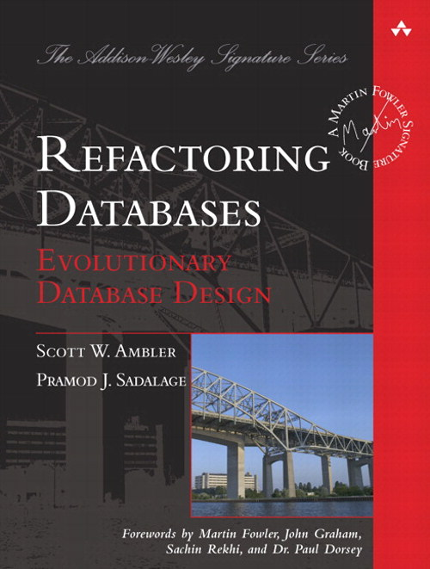
Refactoring Databases Book
Notes:
So I looked at this book, Refactoring Databases. I learned from reading it that I was going to have to learn about triggers, You need triggers to keep the old version and the new version of the data in sync. I hadn’t used triggers before, so I created a test database to learn the concepts.

Slide 7
Sample Refactorings (70 in all)
Add Foreign Key Constraint
Add Lookup Table
Add Parameter to SP
Add Standard Codes
Drop Column
Drop Default Value
Drop Non-Nullable
Introduce Cascading Delete
Introduce Column Constraint
Introduce Surrogate Key
Move Column
Rename Column
Rename Table
Replace One-to-Many with Associative Table
Split Table

Slide 8
Refactoring Database - Strategy
Expand
Convert/copy data and add triggers
Migrate
Remove triggers
Contract

Slide 9
Expand
Add tables
Add columns
Add DEFAULT constraints
Remove UNIQUE, FOREIGN KEY, PRIMARY KEY constraints
Remove CHECK constraints

Slide 10
Migrate
Change stored procedures and functions to use new version
Change other database dependencies
Developers change code to use new version

Slide 11
Contract
Remove tables
Remove columns
Remove DEFAULT constraints
Add UNIQUE, FOREIGN KEY, PRIMARY KEY constraints
Add CHECK constraints

Slide 12
Triggers: what and why
Triggers are stored procedures that run after or instead of DML or DDL.
Why triggers? Refactoring databases, updatable views, complex rules
Why not? Hidden performance problems

Slide 13
Demo
Notes:
Run Setup, show OLD table, Show goals of refactor,
Trigger features
(Will talk about code at top of trigger later.)
UPDATE(column), inserted pseudo-table, deleted pseudo-table
"WHERE Customer.CustomerId = inserted.CustomerId" clause to keep from changing every row.
LEFT OUTER JOIN needed, so ISNULL(deleted.column,...) needed in WHERE clauses.
Both needed to handle INSERT situation.

Slide 14
Lessons Learned
SET RECURSIVE_TRIGGERS OFF/ON
Triggers execute even if table contents doesn’t change
Testing is painful, especially setup, so…
Have a test script
Use version control
Notes:
Discovered the RECURSIVE_TRIGGER option. By default, It’s off. Learned what happens when it’s on, namely…
Triggers execute even if no rows are changed.
Setting up a test is a lot of work, so have a test script.
Automated unit tests is a good idea: you back up and start all over a lot. You need to cover all cases: INSERT/UPDATE; old/new.
Because of lesson #1, version control is probably a good idea
Changelog table was a good debugging tool
=======
Need "WHERE Customer.CustomerId = inserted.CustomerId" clause to keep from changing every row. Tests probably need to verify all rows.
LEFT OUTER JOIN needed, so ISNULL(deleted.column,...) needed in WHERE clauses.
Both needed to handle INSERT situation.

Slide 15
References
Evolutionary Database Design: http://martinfowler.com/articles/evodb.html
Expand/Contract pattern: http://martinfowler.com/bliki/ParallelChange.html
Refactoring Databases book
Etsy 50 deployments/day: http://www.infoq.com/news/2014/03/etsy-deploy-50-times-a-day
http://www.slideshare.net/beamrider9/continuous-deployment-at-etsy-a-tale-of-two-approaches
https://www.simple-talk.com/sql/database-administration/continuous-delivery-and-the-database/

Slide 16
Questions?

